Slide 1

What’s the Matter with the OC?
Jonathan R. Cervas
Ph.D Candidate, Political Science
Click Here for Most Recent Version

Slide 2
After 2016
Clinton first Democrat to win plurality of vote in Orange County in nearly a century.
Republicans won 4 out of 7 Congressional races, even though Hillary Clinton had outperformed the Democratic candidates in those districts
Democrats saw an opening to flip seats in Orange County and made districts there key to the blue wave strategy in 2018
So how did that work out?

Slide 3

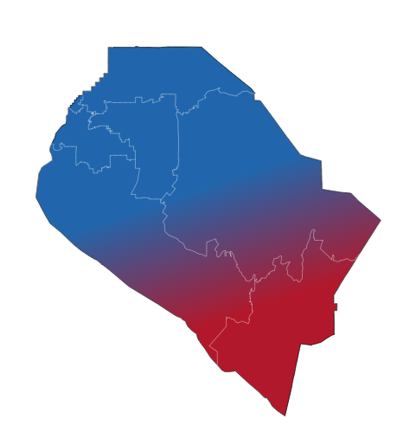
The Puzzle of Political Transformation

Slide 4

Turnout
2014
Registered voters:
1,424,216
Ballots cast:
640,358 (45%)
Early
(0%)
Vote by mail
(39%)
At precinct
(61%)
2018
Registered voters:
1,558,988
Ballots cast:
1,106,729 (70.1%)
Early
(21%)
Vote by mail
(62%)
At precinct
(35%)

Slide 5
Orange County Demographics
Population has increased by nearly 200,000 (6.7%) residents since 2010 census
Estimated 3.2 million residents in Orange County – 6th largest county in the country
2010 –
White – 43.9%
Hispanic – 33.8%
2017 –
White – 40.4%
Hispanic – 34.2%

Slide 6
Rules of the Game
California Top-Two Primary
State Parties are particularly affected

Slide 7
Opinion Change
Vote Choice (county-wide congressional vote)
 | Democrats | Republicans
2014 | 45% | 55%
2018 | 54% | 46%
To what extent can we explain changing patterns of voting in OC to the election of Donald Trump, controlling for changes in turnout, the rules of the game, and demographic change?
?

Slide 8
Governor’s Race
2014
Jerry Brown – 275,707 (44%)
Neel Kashkari – 344,817 (56%)
2018
Gavin Newsom* - 543,047 (50.1%)
John Cox - 539,951 (49.9%)
* Running for Lt Gov in 2014, Gavin received just 41.3% of the two-party vote!
Statewide: Brown 60%, Kashkari 40%
Statewide: Newsom 62%, Cox 38%

Slide 9
CD 38
2014
2018
Campos, Benjamin | 1,988 | 56.8%
* Sanchez, Linda T. | 1,512 | 43.2%
Downing, Ryan | 2,587 | 46.4%
* Sanchez, Linda T. | 2,990 | 53.6%
REP
DEM

Slide 10
CD 39
2014
2018
Kim, Young | 80,123
Cisneros, Gil | 78,059
*Royce, Ed | 63,346 | 70.8%
Anderson, Peter | 26,184 | 29.2%
REP
DEM

Slide 11
CD 45
2014 |  |  |  | 2018
Walters, Mimi | 106,083 | 65.1% | REP | * Walters, Mimi | 146,383 | 47.9%
Leavens, Drew | 56,819 | 34.9% | DEM | Porter, Katie | 158,906 | 52.1%

Slide 12
Demographic Profile
Total Pop:
777,871
White:
472,558 (61%)
Hispanic:
141,853 (18%)
Black:
15,666 (2%)
Asian:
199,942 (26%)
Foreign-born:
226,899 (29%)
Median Household Income:
$102,040
Unemployment:
4%
Percent w/ Bachelors:
55%
Data: 2017 Census ACS 1-year Estimates
CD
45

Slide 13
CD45 - UCI Campus precincts
Turnout – 65.9% (CD45 avg. 73.89%)
Porter – 5,229 (91.8%!)
Walters – 464

Slide 14
CD 46
2014
2018
Nick, Adam | 33,577 | 40.3%
Sanchez, Loretta | 49,738 | 59.7%
Lambert, Rene | 45,638
Correa, Lou | 102,278
REP
DEM

Slide 15
CD 47
2014
2018
Whallon, Andy | 28,761 | 53.1%
*Lowenthal, Alan | 25,376 | 46.9%
Briscoe, John | 40,085
*Lowenthal, Alan | 46,241
REP
DEM

Slide 16
CD 48
2014
2018
*Rohrbacher, Dana | 112,082 | 64.1%
Savary, Suzanne | 62,713 | 35.9%
*Rohrabacher, Dana | 136,899 | 54%
Rouda, Harley | 157,837 | 46%
REP
DEM

Slide 17
CD 49
2014
2018
* Issa, Darrell | 28,410 | 68.8%
Peiser, Dave | 12,892 | 31.2%
Harkey, Diane L. | 40,325
Levin, Mike | 35,124
REP
DEM

Slide 18
RAW VOTES IN CONGRESSIONAL DISTRICTS, ORANGE COUNTY ONLY

Slide 19
Net change in raw votes, 2014->2018

Slide 20
Percentage Change in votes 2014->2018

Slide 21

Conclusions
Democrats now hold all 7 of the Orange County congressional districts
Clinton (2016) and Newsome (2018) won the county-wide vote
Democrats has a 113% increase in votes in 2018 compared to 2014; Republicans increased just 46%.
2020 – No Governor’s race, US Senate race, and Presidential race unlikely to be competitive in CA.
Republicans hold just 7 (13.2%) Congressional Districts in ALL of California
More investigation is needed to parse what is happening, especially in terms of my puzzle.

